Slide 1
Hadoop Map-Reduce
Created By: Ami Pandya
Parth Patel

Slide 2
Table Of Contents
What is Hadoop?
Why Use Hadoop?
Hadoop Components
Map Reduce
Isolated Tasks
Data Distribution
Task Scheduling
Job Scheduling
Map Reduce Functioning
Key and Values
Fault Tolerance
Demo

Slide 3
What is Hadoop ?
It i s a framework of tools to support bigdata application
Open-source software framework for storing data and running applications on clusters of commodity hardware.
Provides massive storage for any kind of data, enormous processing power .
Provides the ability to handle virtually limitless concurrent tasks or jobs.

Slide 4
Bigdata problems
Volume- a large amount of data.
Variety - it could be an audio file video file or database files
Velocity - a data is coming at very high speeed.

Slide 5

Why Use Hadoop?
Faster:
Parallel Data processing
Better:
Suited for particular types of Big Data Problems
Cheaper:
Scales to petabytes or more.

Slide 6
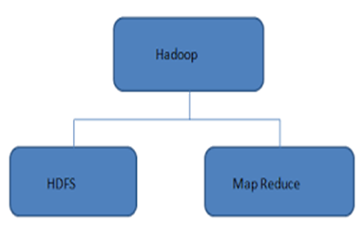
Hadoop Core Components
HDFS:
Data Storage
Runs on Commodity Hardware
Horizontally Scalable
MapReduce:
Parallelized /Scalable Processing
Fault Tolerant.

Slide 7
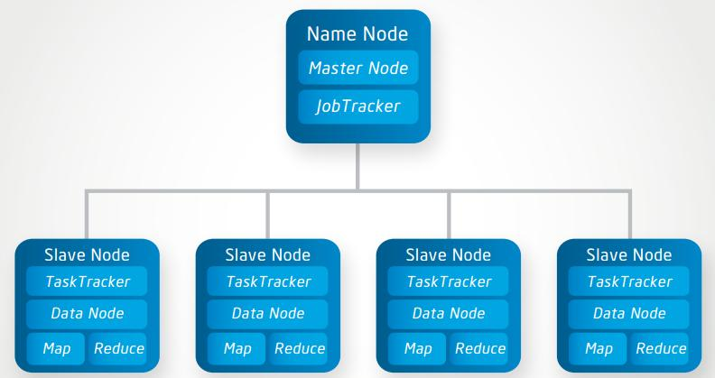
HDFS Architecture

Slide 8
Components of HDFS
Namenode is the master of the system. It maintains the name system (directories and files) and manages the blocks which are present on the Datanodes.
Datanodes are the slaves which are deployed on each machine and provide the actual stor­age. They are responsible for serving read and write requests for the clients.
Secondary Namenode is responsible for performing periodic checkpoints. In the event of Namenode failure, you can restart the Namenode using the checkpoint.

Slide 9
Map Reduce
MapReduce is a programming model for data processing
It was originally published by Google in 2004.
The power of MapReduce lies in its ability to scale to 100s or 1000s of computers, each with several processor cores.

Slide 10
Data distribution and Isolated Tasks
In a MapReduce cluster, data is distributed to all the nodes of the cluster as it is being loaded in.
An underlying distributed file systems (e.g., GFS) splits large data files into chunks which are managed by different nodes in the cluster
Even though the file chunks are distributed across several machines, they form a single namespace.
MapReduce divides the workload into multiple independent tasks and schedule them across cluster nodes.
A work performed by each task is done in isolation from one another.

Slide 11
Task Scheduling in MapReduce
MapReduce adopts a master-slave architecture with Name Node(Master) and Data Node(Slave).
The master node in MapReduce is referred to as Job Tracker.
Each slave node in MapReduce is referred to as Task Tracker.
MapReduce adopts a pull scheduling strategy rather than a push one
I.e., JT does not push map and reduce tasks to TTs but rather TTs pull them by making pertaining requests
Every task tracker sends a heartbeat message periodically to Job tracker encompassing a request for a map or a reduce task to run.

Slide 12
Job Scheduling In MapReduce
In MapReduce, an application is represented as a job
A job encompasses multiple map and reduce tasks.
MapReduce in Hadoop comes with a choice of schedulers:
default is the FIFO scheduler which schedule jobs in order of submission.
There is also a multi-user scheduler called the Fair scheduler which aims to give every user a fair share of the cluster capacity over time.

Slide 13
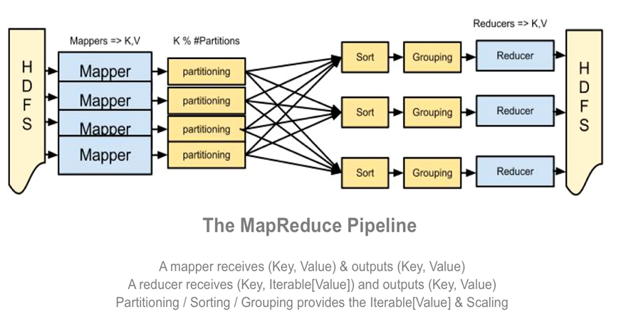
MapReduce Functioning: Logical View

Slide 14
MapReduce Functioning Contd…
Hadoop divides the input files stored on HDFS into splits and assigns every split to a a different mapper, trying to assign every split to the mapper where the split physically resides.
MapReduce basically breaks the data flow into two phases : map phase and Reduce phase.
Mappers: Hadoop reads the split of the mapper line by line.
It calls the method map() of the mapper for every line passing it as the key/value parameters.
The mapper computes its application logic and emits other key/value pairs.
Shuffle and Sort: Hadoop's partitioner divides the emitted output of the mapper into partitions, each of those is sent to a different reducer.
It collects all the different partitions received from the mappers and sort them by key.
Reducer:
Hadoop reads the aggregated partitions line by line.
It calls the reduce() method on the reducer for every line of the input.
The reducer computed its application logic and emits other key/value pairs.
Finally, Hadoop writes the emitted pairs output to HDFS. So, the reducer produces the final outputs.

Slide 15
Keys and Values
The programmer in MapReduce has to specify two functions, the map function and the reduce function that implement the Mapper and the Reducer in a MapReduce program
In MapReduce data elements are always structured as key-value (i.e., (K, V)) pairs
The map and reduce functions receive and emit (K, V) pairs

Slide 16
Fault Tolerance in HDFS
Common Types of Failures:
NameNode failures
Data Node failures
Handling Data Node Failure
Each Data Node sends a heartbeat message to the NameNode periodically.
If the NameNode does not receive a heartbeat from a particular data node for 10 minutes, then it considers that data node to be dead/out of service.
Name Node initiates replication of blocks which were hosted on that data node to be hosted on some other data node.

Slide 17
Handling Name Node Failure
Single Name Node per cluster.
If NameNode becomes unavailable, the cluster as a whole would be unavailable.
NameNode has to be restarted
Brought up on a separate machine.

Slide 18
Fault Tolerance Cont..
MapReduce can guide jobs toward a successful completion even when jobs are run on a large cluster where probability of failures increases.
Restarting Tasks is the primary way that MapReduce use to achieve fault tolerance.
If a Task Tracker fails to communicate with Job Tracker for a period of time (by default, 1 minute in Hadoop), Job Tracker will assume that Task Tracker in process has crashed.
If the job is still in the map phase, Job Tracker asks another Task Tracker to re-execute all Mappers that previously ran at the failed Task Tracker.
If the job is in the reduce phase, Job Tracker asks another Task Tracker to re-execute all Reducers that were in progress on the failed Task Tracker.

Slide 19


